Slide 1
SOFTWARE DEVELOPMENT FUNDAMENTALS

Slide 2
WHY SOFTWARE DEVELOPMENT
SOFTWARE DEVELOPMENT IS A CRUCIAL FIELD THAT INVOLVES CREATING, DESIGNING, TESTING AND MAINTING COMPUTER PROGRAMS AND APLLICATIONS.
GROWING DEMAND
PROBLEM SOLVING
GLOBAL IMPACT
CONTINUOUS LEARNING
JOB SECURITY

Slide 3
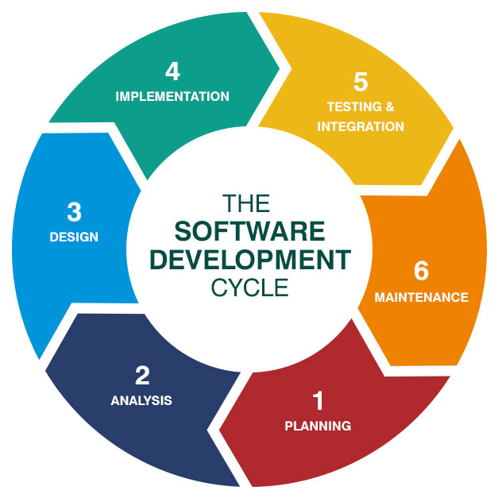
SDLC – SOFTWARE DEVELOPMENT LIFE CYCLE

Slide 4
PLANNING
DEVELOP A COMPREHENSIVE PROJECT PLAN, INCLUDING TIMELINES, RESOURCES, AND BUDGETS.
IDENTIFY POTENTIAL RISKS AND PLAN FOR RISK MITIGATION STRATEGIES.
DETERMINE THE PROJECT’S ARCHITECTURE, TECHNOLOGIES AND TOOLS.

Slide 5
ANALYSIS
DOCUMENT AND DETAILED INFORMATION ABOUT PROJECTS REQUIREMENTS.
REQUIREMENTS ELICITATION
REQUIREMENTS ANALYSIS
SCOPE DEFINITION
RISK ASSESSMENT
DOCUMENTATION

Slide 6
DESIGN
CREATE A DETAILED DESIGN OF THE SOFTWARE’S ARCHITECTURE, COMPONENETS AND INTERFACES.
DESIGN THE UI AND UX BASED ON USER REQUIREMENTS
DEFINE DATA MODELS AND DATABASE STRUCTURES IF APPLICABLE.

Slide 7
IMPLEMENTATION
WRITE THE ACTUAL CODE BASED ON THE DESIGN SPECIFICATION.
FOLLOW CODING STANDARDS AND BEST PRACTICES TO ENSURE READABILITY AND MAINTAINABILTY.
DEVELOP UNIT TESTS TO VALIDATE THE CORRECTNESS OF INDIVIDUAL CODE COMPONENETS.

Slide 8
TESTING & INTEGRATION
CONDUCT VARIOUS TESTING ACTIVITIES INCLUDING UNIT TESTIING, INTEGRATION TESTING AND SYSTEM TESTING.
IDENTIFY AND FIX DEFECTS OR ISSUES DISCOVERED DURING TESTING.
ENSURE THAT THE SOFTWARE MEETS THE SPECIFIED REQUIREMENTS AND FUNCTIONS AS EXPECTED.

Slide 9
DEPLOYMENT
PREPARE THE SOFTWARE FOR DEPLOYMENT TO THE PRODUCTIVE ENVIRONMENT.
MIGRATE DATA FROM THE DEVELOPMENT ENVIRONMENT TO THE PRODUCTION ENVIRONMENT.
PERFORM FINAL TESTING IN THE PRODUCTION ENVIRONMENT BEFORE RELEASING THE SOFTWARE TO USERS.

Slide 10
MAINTENANCE AND SUPPORT
MONITOR THE SOFTWARE IN THE PRODUCTION ENVIRONMENT AND ADDRESS ANY ISSUES THAT ARISE.
PROVIDE ONGOING SUPPORT AND UPDATES TO FIX BUGS, ADD NEW FEATURES OR IMPROVE PERFORMANCE.
PERFORM PERIODIC ASSESSMENTS TO ENSURE THE SOFTWARE REMAINS RELEVENT AND EFFECTIVE.

